Slide 1


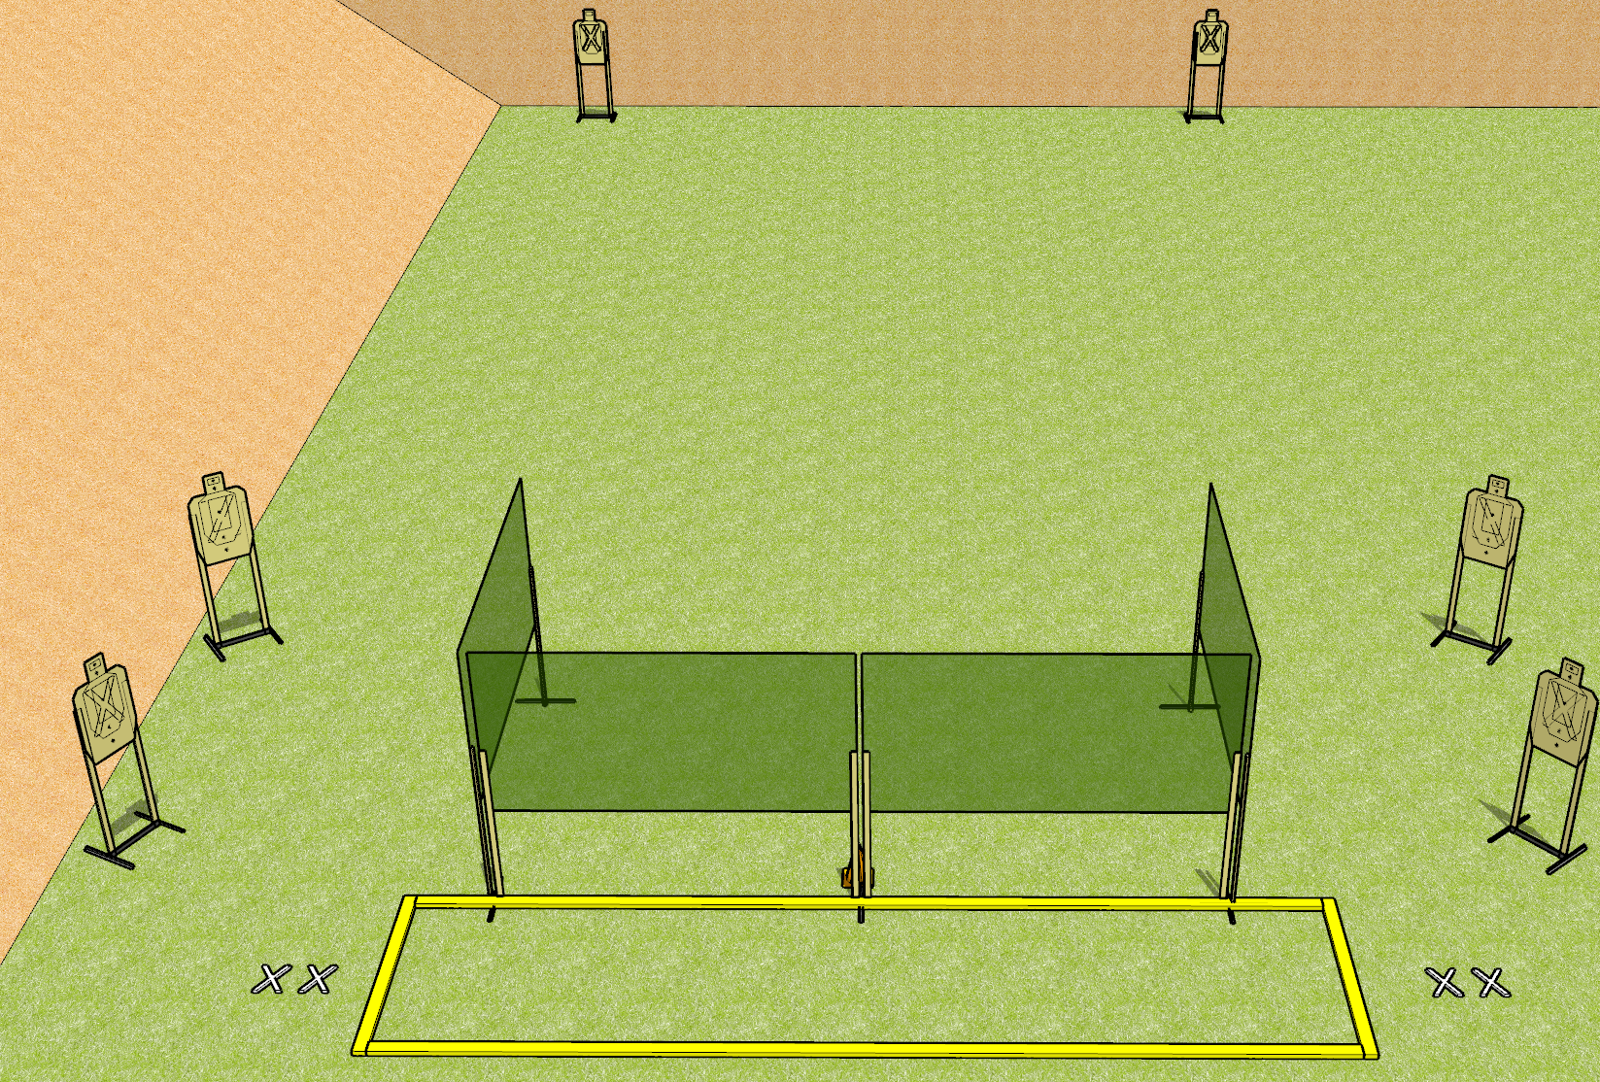
 | Dothan Gun Club – USPSA Match Bring Me Your Hate Course Designer : Drew Coleman
START POSITION : String 1: Standing with both feet on either set of X’s, wrists below belt. String 2: Standing with both feet on opposite set of X’s from string 1, wrists below belt.
GUN READY CONDITION : Pistol loaded and holstered. PCC loaded, shouldered, safety on, pointed at orange cone. |  | SCORING: Virginia Count, 12 rounds TARGETS: 6 paper, 0 Steel SCORED HITS: Best 4 on paper, steel until down START-STOP: Audible, last shot RULES:
STAGE PROCEDURE: String 1: Engage T1-T3 OR T4-T6 with only two rounds each, perform a mandatory reload, then engage remaining array with only two rounds each. String 2: Engage T1-T3 OR T4-T6 with only two rounds each, perform a mandatory reload, then engage remaining array with only two rounds each strong hand only.
T3
T4
T2
T5
T1
T6

Slide 2
Bring Me Your Hate
Written Stage Briefing
Bring Me Your Hate is a 24 round, 120 point, Virginia Count Standard Exercise. There are six USPSA targets. The best four hits on paper will score. The start signal is audible. There are two strings of fire.
Handgun start position for string one is standing with both feet on either set of X’s with pistol loaded and holstered, wrists below belt. The start position for string two is standing with both feet on the opposite set of X’s with pistol loaded and holstered, wrists below belt.
PCC start position for string one is standing with both feet on either set of X’s with loaded carbine held with both hands, safety on, shouldered, pointed at either orange cone. The start position for string two is standing on the opposite set of X’s with loaded carbine held with both hands, safety on, shouldered, pointed at either orange cone.
Targets are designated T1 through T6, from left to right per the stage diagram. Stage procedure for string one is to engage T1-T3 OR T4-T6 from within the shooting area with only two rounds each, perform a mandatory reload, then engage the remaining array with only two rounds each. Stage procedure for string two is to engage T1-T3 OR T4-T6 from within the shooting area with only two rounds each, perform a mandatory reload, then engage the remaining array with only two rounds each strong hand only.

